Slide 1
SHAFTS DESIGN

Slide 2
Shafts
A shaft is the component of a mechanical device that transmits rotational motion and power.
Can you identify some kinds of mechanical systems incorporating rotating elements that transmit power?
Here are some examples: gear-type speed reducers, belt or chain drives, conveyors, pumps, fans, agitators, and many types of automation equipment.
Consider household appliances, lawn maintenance equipment, parts of a car, power tools, and machines around an office or in your workplace.

Slide 3
Forces on Shafts
Also, a shaft usually carries power-transmitting components, such as gears, belt sheaves, or chain sprockets, which exert forces on the shaft in the transverse direction (perpendicular to its axis).
These transverse forces cause bending moments to be developed in the shaft, requiring analysis of the stress due to bending.

Slide 4
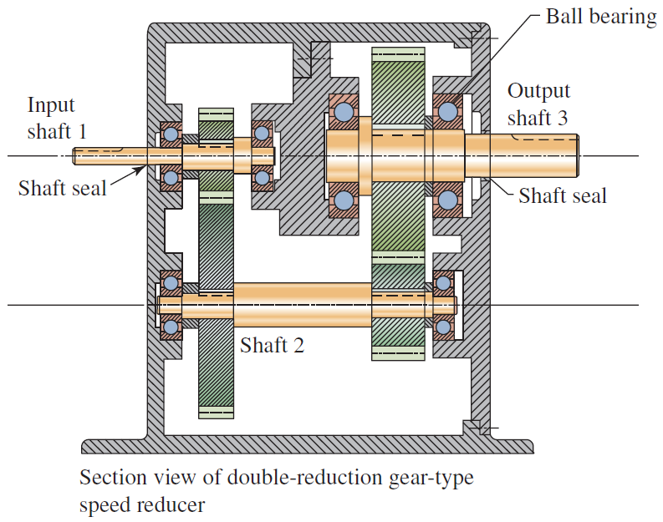
You are the designer…

Slide 5
Shaft Design Procedure
Because of the simultaneous occurrence of torsional shear stresses and normal stresses due to bending, the stress analysis of a shaft virtually always involves the use of a combined stress approach.
The recommended approach for shaft design and analysis is the distortion energy theory of failure.

Slide 6
PROCEDURE FOR DESIGN OF A SHAFT
Determine the rotational speed of the shaft.
Determine the power or the torque to be transmitted by the shaft.
Determine the design of the power-transmitting components or other devices that will be mounted on the shaft and specify the required location of each device.
Specify the location of bearings to support the shaft. Normally two and only two bearings are used to support a shaft.

Slide 7
PROCEDURE FOR DESIGN OF A SHAFT
Propose the general form of the geometry for the shaft, considering how each element on the shaft will be held in position axially and how power transmission from each element to the shaft is to take place.
Determine the magnitude of torque that the shaft sees at all points. It is recommended that a torque diagram be prepared, as will be shown later.
Determine the forces that are exerted on the shaft, both radially and axially.

Slide 8
PROCEDURE FOR DESIGN OF A SHAFT
Resolve the radial forces into components in perpendicular directions, usually vertically and horizontally.
Solve for the reactions on all support bearings in each plane.
Produce the complete shearing force and bending moment diagrams to determine the distribution of bending moments in the shaft.

Slide 9
PROCEDURE FOR DESIGN OF A SHAFT
Select the material from which the shaft will be made, and specify its condition: cold-drawn, heat-treated, and so on. As indicated in Table 2–9, suggested steel materials for shafts are plain carbon or alloy steels with medium carbon content, such as SAE 1040, 4140, 4340, 4640, 5150, 6150, and 8650.
Determine an appropriate design stress, considering the manner of loading (smooth, shock, repeated and reversed, or other).

Slide 10
PROCEDURE FOR DESIGN OF A SHAFT
Analyze each critical point of the shaft to determine the minimum acceptable diameter of the shaft at that point in order to ensure safety under the loading at that point.
Specify the final dimensions, surface finishes, tolerances, geometric dimensioning details, fillet radii, shoulder heights, keyseat dimensions, retaining ring groove geometry, and other details for each part of the shaft, ensuring that the minimum diameter dimensions from Step 13 are satisfied.

Slide 11
Other Considerations for Shaft Design
Power-transmission elements such as gears, belt sheaves, and chain sprockets are typically placed on shafts with small clearances to facilitate assembly while retaining reliable operation.
The inner races of rolling contact bearings are typically mounted on shafts with a light interference fit as specified by the bearing manufacturer. It is essential that bearing manufacturer’s specifications are shown on the shaft drawing.

Slide 12
Other Considerations for Shaft Design
Because of the close tolerances at bearing seats, these parts of the shaft are typically ground. Other parts may be produced by turning with fine-finishing passes to achieve the desired fit and satisfactory fatigue performance.
Keyseats in the shaft should be dimensioned, giving the S dimension for ease of manufacture.
Stress concentrations should be taken into account where shaft diameter changes. The designer is expected to specify the final fillet radii that result in safe stresses.

Slide 13
Other Considerations for Shaft Design
Retaining ring manufacturers specify the dimensioning and tolerancing required for the grooves into which the rings are seated.
Axial dimensions for shaft features are typically shown relative to some critical datum feature such as a shoulder against which a gear or bearing is mounted

Slide 14
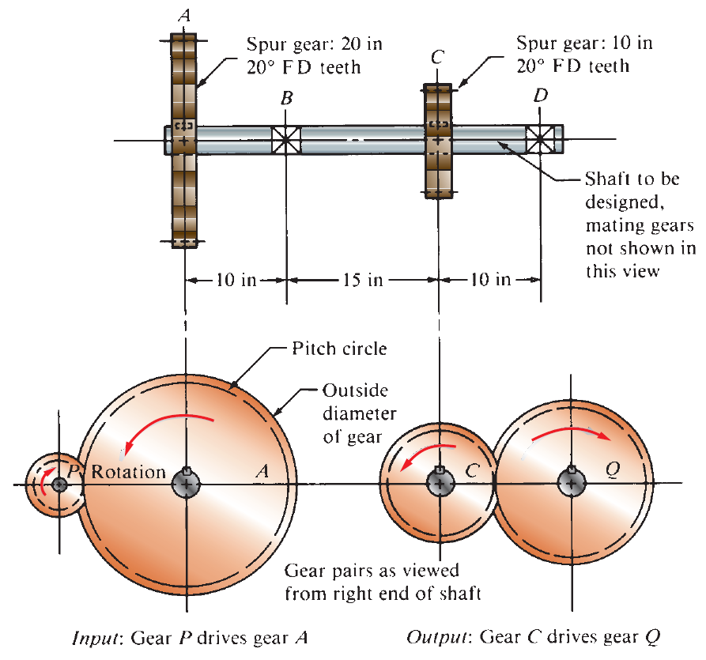
Example

Slide 15
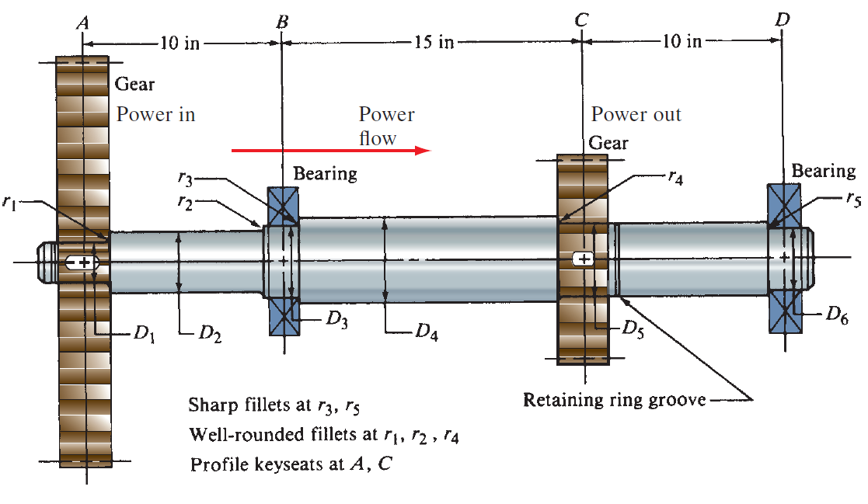
Shaft Design
Proposed geometry for the shaft

Slide 16
Force Exerted on Shafts by Machine Elements
Gears, belt sheaves and pulleys, chain sprockets, and other elements typically carried by shafts exert forces on the shaft that cause bending moments.

Slide 17
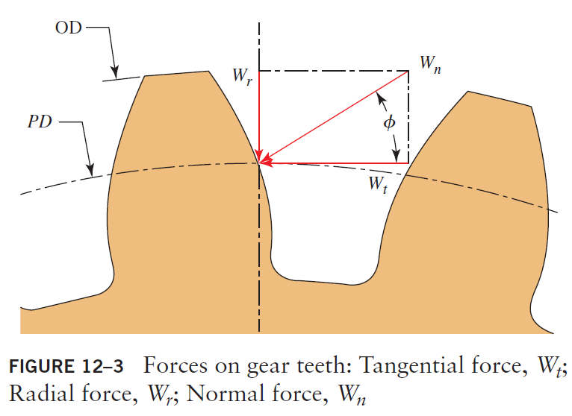

Force Exerted on Shafts by Machine Elements
Spur Gears: The force exerted on a gear tooth during power transmission acts normal (perpendicular) to the involutetooth profile.

Slide 18
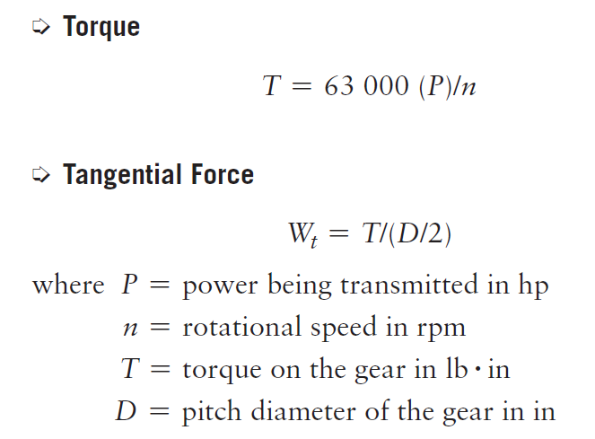
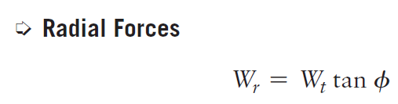
Force Exerted on Shafts by Machine Elements
Spur Gears:
It is most convenient to compute the tangential force, Wt, directly from the known torque being transmitted by the gear.

Slide 19
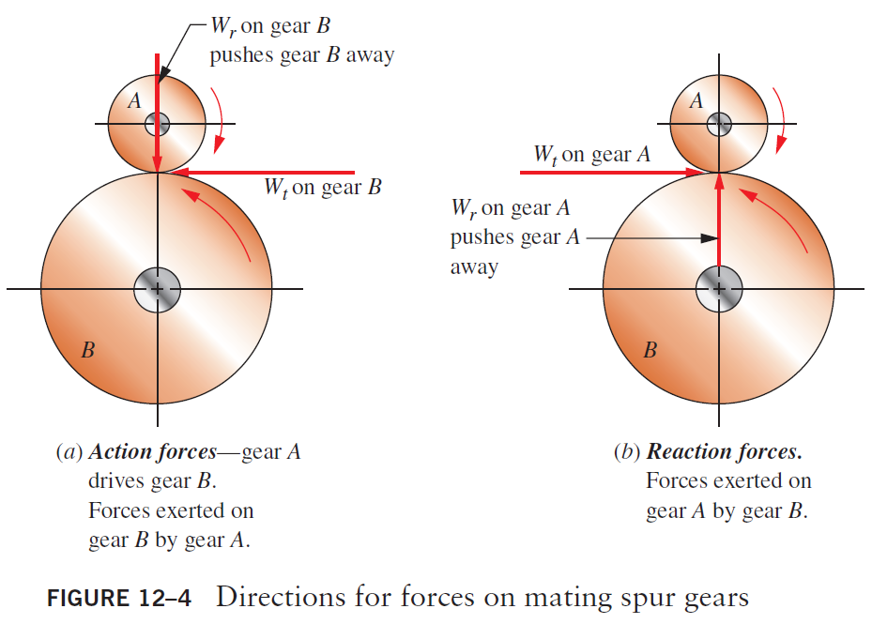
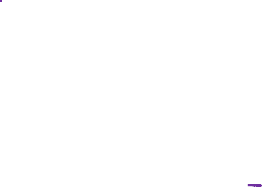
Directions for Forces on Mating Spur Gears

Slide 20
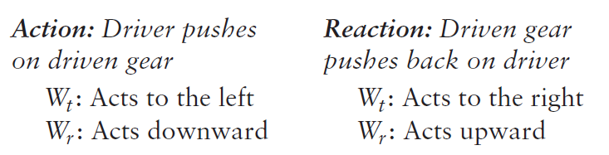
Directions for Forces on Mating Spur Gears
Whenever you need to determine the direction of forces acting on a given gear, first determine whether it is a driver or a driven gear.

Slide 21
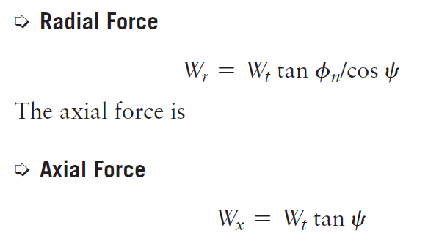

Force Exerted on Shafts by Machine Elements
Helical Gears: In addition to the tangential and radial forces encountered with spur gears, helical gears produce an axial force.
If the helix angle of the gear is $ψ$, and if the normal pressure angle is $φ_{n}$, the radial force can be computed from

Slide 22
Force Exerted on Shafts by Machine Elements
Chain Sprockets:
The upper part of the chain is in tension and produces the torque on either sprocket. The lower part of the chain, referred to as the slack side, exerts no force on either sprocket.
Therefore, the total bending force on the shaft carrying the sprocket is equal to the tension in the tight side of the chain.

Slide 23
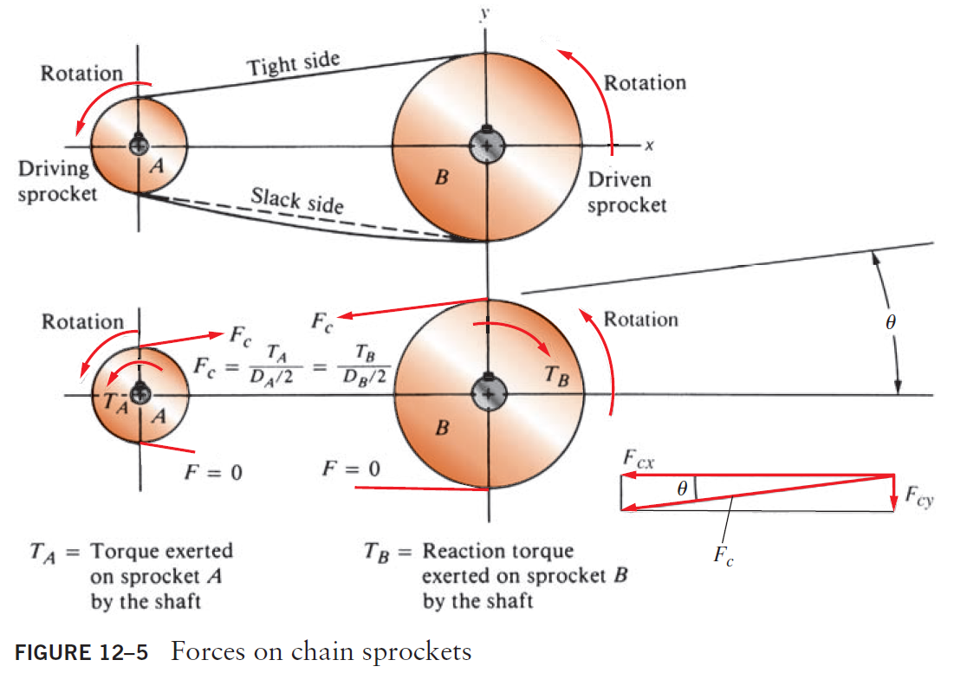
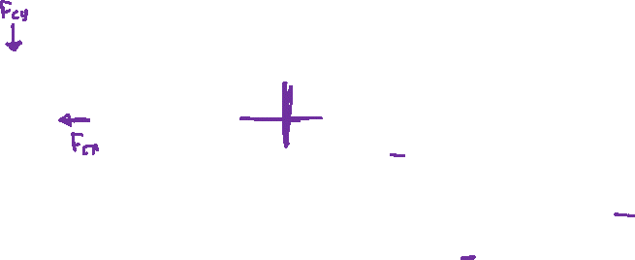
Force Exerted on Shafts by Machine Elements
Chain Sprockets:

Slide 24
Force Exerted on Shafts by Machine Elements
Chain Sprockets:
These two components of the force would cause bending in both the x-direction and the y-direction. Alternatively, the analysis could be carried out in the direction of the force, Fc, in which single plane bending occurs.

Slide 25
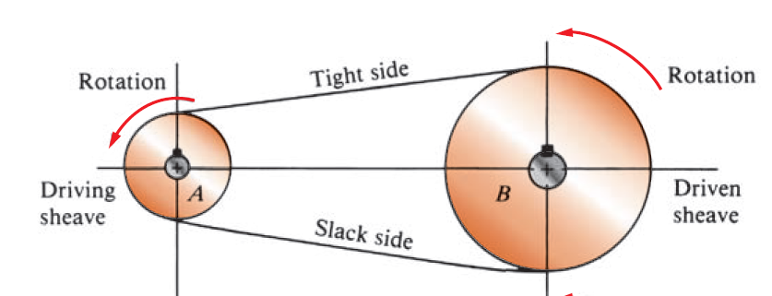
Force Exerted on Shafts by Machine Elements
V-Belt Sheaves:
The general appearance of the V-belt drive system looks similar to the chain drive system. But there is one important difference: Both sides of the V-belt are in tension.

Slide 26


Force Exerted on Shafts by Machine Elements
V-Belt Sheaves:
The tight side tension, F1, is greater than the “slack side” tension, F2, and thus there is a net driving force on the sheaves equal to:
The magnitude of the net driving force can be computed from the torque transmitted:

Slide 27

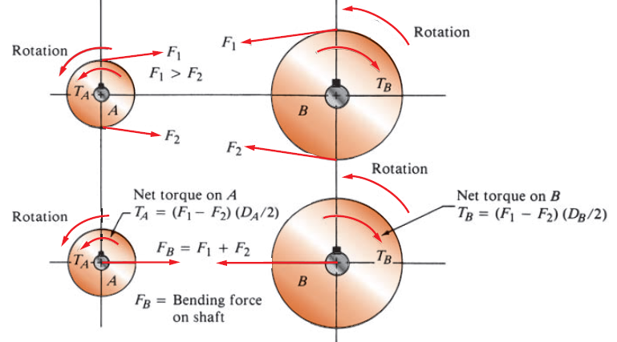
Force Exerted on Shafts by Machine Elements
V-Belt Sheaves: Bending Force for V-Belts.

Slide 28

Flat Belt Drives
The analysis of the bending force exerted on shafts by flat-belt pulleys is identical to that for V-belt sheaves except that the ratio of the tight side to the slack side tension is typically considered 3 instead of 5.
Using the same logic as with V-belt sheaves, we can compute the constant C to be 2.0. Then, for flat-belt drives,

Slide 29
Flexible Coupling
A flexible coupling transmits power between shafts while accommodating minor misalignments in the radial, angular, or axial directions. Thus, the shafts adjacent to the couplings are subjected to torsion, but the misalignments cause no axial or bending loads.

Slide 30
Stress Concentrations in Shafts
In order to mount and locate the several types of machine elements on shafts properly, a final design typically contains several diameters, keyseats, ring grooves, and other geometric discontinuities that create stress concentrations.

Slide 31
Stress Concentrations in Shafts
These stress concentrations must be taken into account during the design analysis.
We need to determine the values of stress concentration factors for the changes in diameters caused by attachment of elements to the shafts.
One way is to decide on the preliminary design values of stress concentration factors (K_{t}).

Slide 32
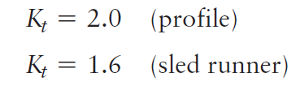
Preliminary Design Values for Kt
Keyseats:
A keyseat is a longitudinal groove cut into a shaft for the mounting of a key, permitting the transfer of torque from the shaft to a power-transmitting element, or vice versa.
Two types of keyseats are most frequently used: profile and sled runner.
Normally used design values are

Slide 33
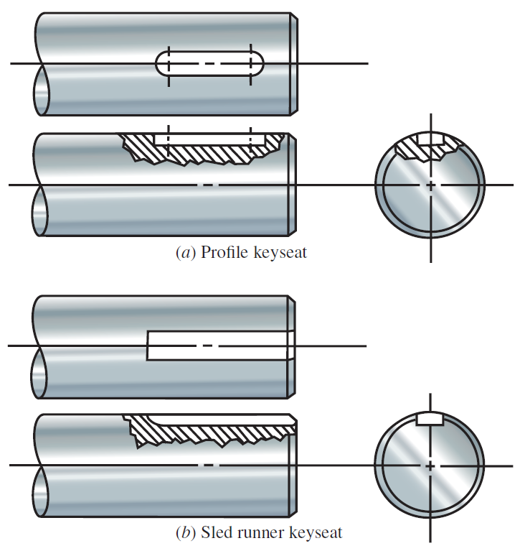
Preliminary Design Values for Kt
Keyseats:

Slide 34
Preliminary Design Values for Kt
Shoulder Fillets:
When a change in diameter occurs in a shaft to create a shoulder against which to locate a machine element, a stress concentration dependent on the ratio of the two diameters and on the radius in the fillet is produced.
For the purpose of design, we will classify fillets into two categories: sharp and well-rounded.

Slide 35
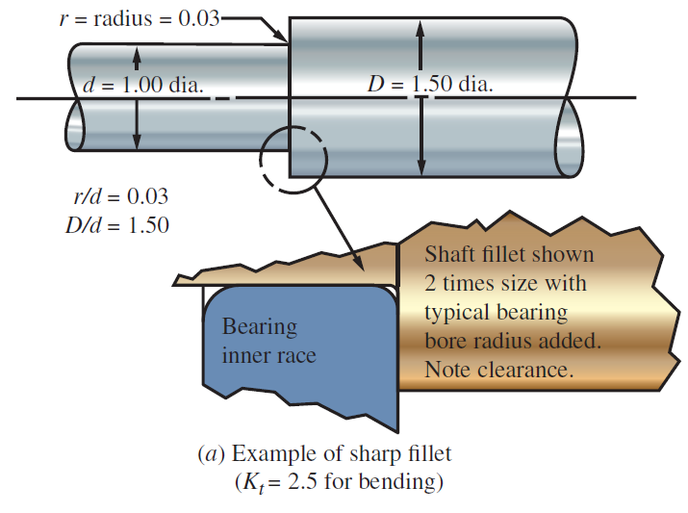
Preliminary Design Values for Kt
Shoulder Fillets:

Slide 36
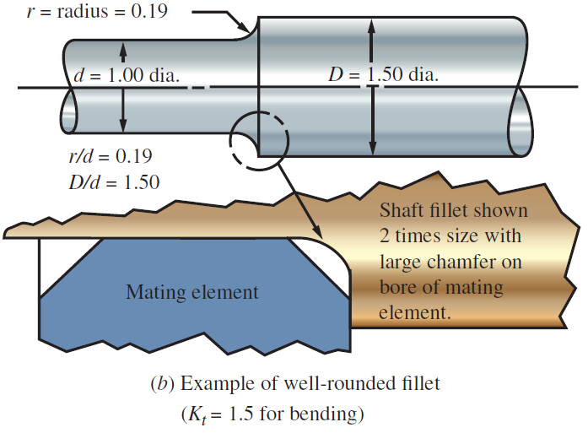
Preliminary Design Values for Kt
Shoulder Fillets:

Slide 37
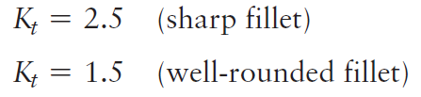
Preliminary Design Values for Kt
Shoulder Fillets:
When an element with a large chamfer on its bore is located against the shoulder, or when nothing at all seats against the shoulder, the fillet radius can be much larger (well-rounded), and the corresponding stress concentration factor is smaller.
We will use the following values for design for bending:
These values correspond to ratios of r/d of approximately 0.03 for the sharp fillet case and 0.19 for the well-rounded fillet for a D/d ratio of 1.50.

Slide 38
Retaining Rings
For preliminary design, we will apply K_{t} = 3.0 to the bending stress at a retaining ring groove to account for the rather sharp fillet radii. The stress concentration factor is not applied to the torsional shear stress if it is steady in one direction.

Slide 39
Design Stresses for Shafts
In a given shaft, several different stress conditions can exist at the same time.
For any part of the shaft that transmits power, there will be a torsional shear stress, while bending stress is usually present on the same parts.

Slide 40
Design Stresses for Shafts
The bending stresses will be assumed to be completely reversed and repeated because
of the rotation of the shaft. Because ductile materials perform better under such loads, it
will be assumed that the material for the shaft is ductile. It will also be assumed that the
torsional loading is relatively constant and acting in one direction.
The symbol τd will be used for the design stress when shear stress is the basis for the design. The symbol σd will be used when normal stress is the basis.

Slide 41

Design Shear Stress—Steady Torque
The best predictor of failure in ductile materials due to a steady shear stress was the distortion energy theory in which the design shear stress is computed from
We will use this value for steady torsional shear stress, vertical shear stress, or direct shear stress in a shaft.

Slide 42

Design Shear Stress—Reversed Vertical Shear
Points on a shaft where no torque is applied and where the bending moments are zero or very low are often subjected to significant vertical shearing forces which then govern the design analysis.
This typically occurs where a bearing supports an end of a shaft and where no torque is transmitted in that part of the shaft.

Slide 43
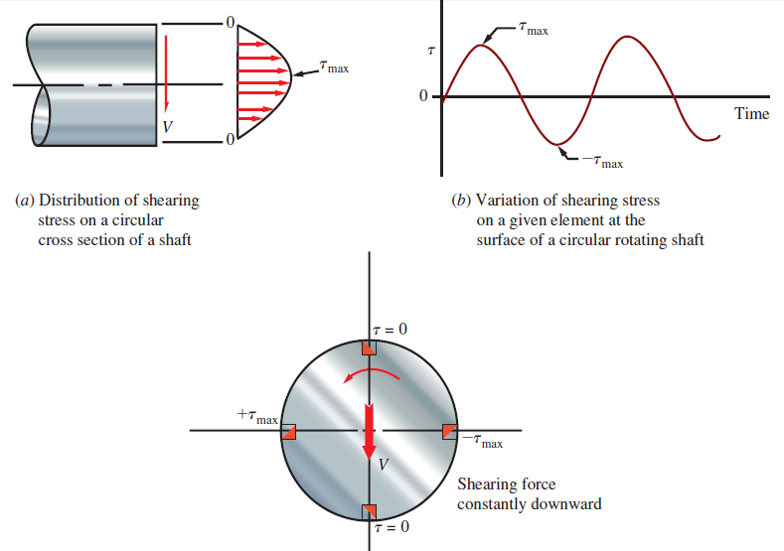

Design Shear Stress—Reversed Vertical Shear

Slide 44

Design Shear Stress—Reversed Vertical Shear
Where:
K_{t} is the stress concentration factor
V is the vertical shear force
N is the design factor (section 5-9)
s’_{n} is the estimated actual endurance limit.
This equation should be used to compute the required diameter for a shaft where a vertical shearing force V is the only significant loading present.
In most shafts, the resulting diameter will be much smaller than that required at other parts of the shaft where significant values of torque and bending moment occur.

Slide 45

Design Normal Stress—Fatigue Loading
For the repeated and reversed bending in a shaft caused by transverse loads applied to the rotating shaft, the design stress is related to the endurance strength of the shaft material.
The actual conditions under which the shaft is manufactured and operated should be considered when specifying the design stress.
The design stress used here for parts of the shaft subjected to reversed bending stress due to the rotation of the shaft is

Slide 46
Other factors that affect the shaft design
Some other factors that affect the shaft design and were not considered in the discussion before:
Variation in peak stress levels above the nominal endurance strength for some periods of time, even quite short periods for high overstressing.
Temperatures above approximately 400°F (204°C).
Vibration that induces variations in stress not included in the analysis.
Residual stresses: dangerous when tensile, possibly beneficial when compressive.
Case hardening of the shaft material, resulting in nonuniform strength distribution near the surface and changing the net endurance strength.

Slide 47
Other factors that affect the shaft design
Some other factors that affect the shaft design and were not considered in the discussion before:
Interference fits of mating elements that introduce additional local stresses and stress concentrations.
Corrosion that may roughen the surface and decrease the effective endurance strength.
Thermal cycling over and above the applied stresses, changing the span of stress cycles.
Axial tensile or compressive stresses.

Slide 48
Design Factor N
We will typically use N = 2.5 to 3.0, indicating moderate uncertainty about actual material strengths, loading conditions, and long-term environmental factors. (Chapter:5)
Higher values are sometimes justified for critical designs without knowing actual conditions. Conversely, lower values can be used when extensive, reliable data are available.

Slide 49
Shafts in bending and torsion only

Slide 50
Shaft design for bending and torsion only
Examples of shafts subjected to bending and torsion only are those carrying spur gears, V-belt sheaves, or chain sprockets.
The power being transmitted causes the torsion, and the transverse forces on the elements cause bending.
In such cases, the bending moment diagrams for two perpendicular planes are prepared first.
Then the resultant bending moment at each point of interest is determined.

Slide 51
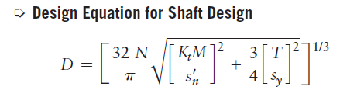
Shaft design for bending and torsion only
A design equation is developed based on the assumption that the bending stress in the shaft is repeated and reversed as the shaft rotates, but that the torsional shear stress is nearly uniform.
This equation can be used for pure bending or pure torsion

Slide 52

Design Example
Design the shaft shown in Figures 12–1 and 12–2. It is to be machined from SAE 1144 OQT 1000 steel. The shaft is part of the drive for a large blower system supplying air to a furnace. Gear A receives 200 hp from gear P. Gear C delivers the power to gear Q. The shaft rotates at 600 rpm. Use D_{A} = 20.00 in. and D_{C} = 10.00 in. Pressure angle = $φ$= 20.

Slide 53
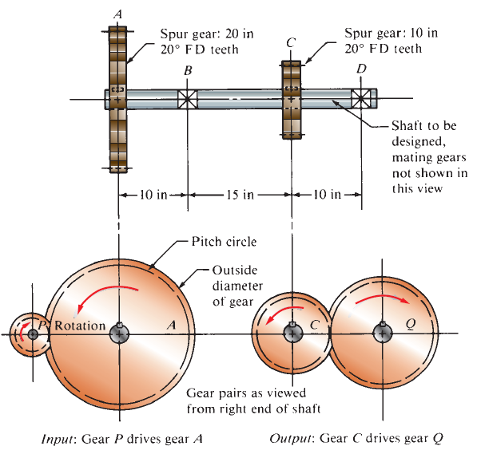
Design Example

Slide 54
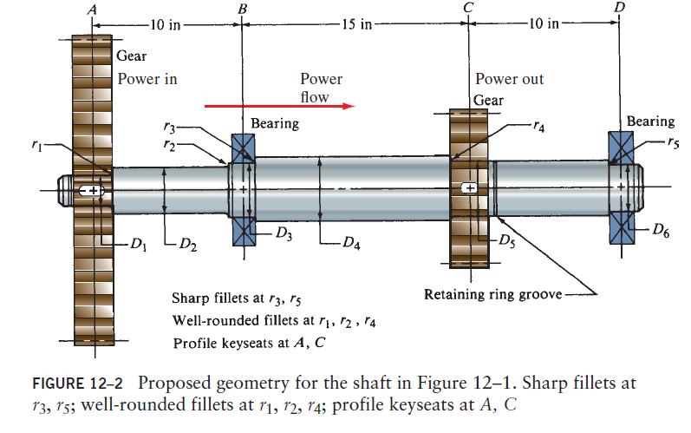
Design Example

Slide 55
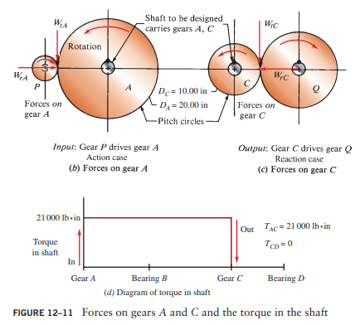
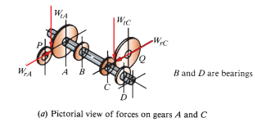

Slide 56
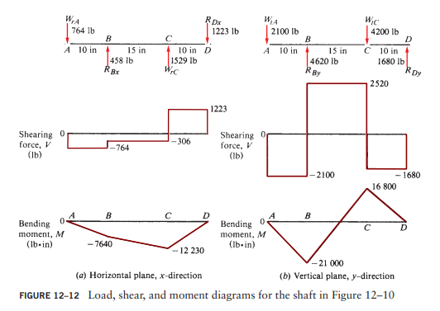

Slide 57
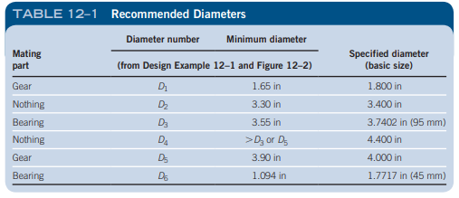
Examples 12.1 1n 12.2 some combinations of spur gears, belt sheaves, and chain sprockets that exert forces normal to the shaft to cause bending.
The forces may act in any direction around the shaft depending on the placement of mating elements.
Notice that none of these types of elements exerts forces parallel to the axis of the shaft tending to cause direct axial tension or compression.

Slide 58
Problem
The shaft shown in Figure 12–13 receives 110 hp from a water turbine through a chain sprocket at point C. The gear pair at E delivers 80 hp to an electrical generator. The V-belt sheave at A delivers 30 hp to a bucket elevator that carries grain to an elevated hopper. The shaft rotates at 1700 rpm. The sprocket, sheave, and gear are located axially by retaining rings. The sheave and gear are keyed with sled runner keyseats, and there is a profile keyseat at the sprocket. Use SAE 1040 cold-drawn steel for the shaft.
Compute the minimum acceptable diameters D1 through D7 as defined in Figure 12–13.

Slide 59
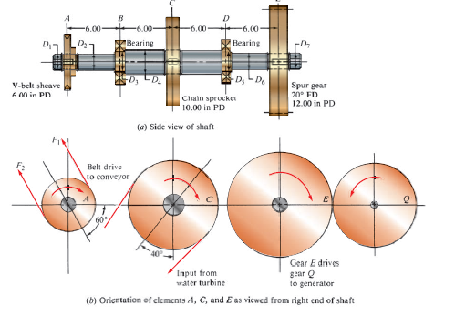

Slide 60
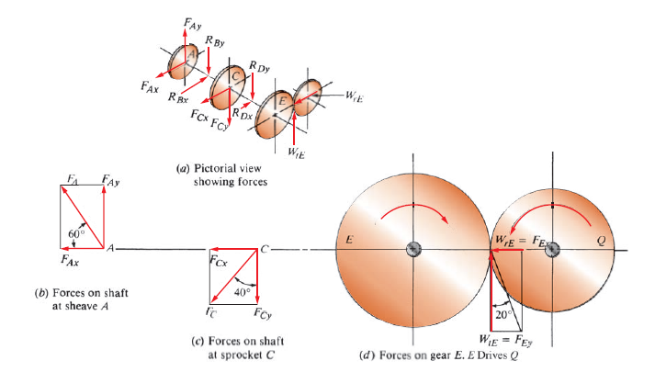

Slide 61
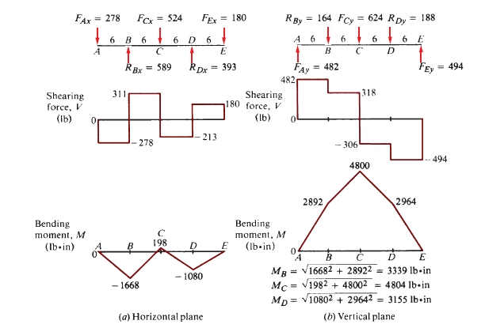

Slide 62
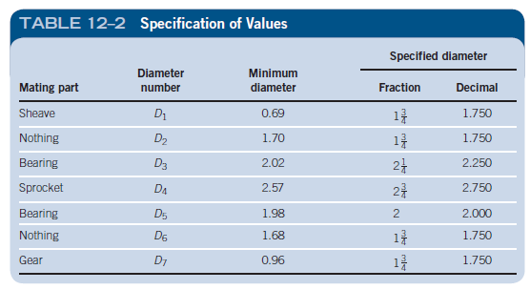

Slide 63
For preliminary design, we will apply Kt = 3.0 to the bending stress at a retaining ring groove to account
for the rather sharp fillet radii. The stress concentration factor is not applied to the torsional shear stress if it is steady in one direction.
The computed estimate for the minimum required diameter at a ring groove is at the base of the groove.
You should increase this value by approximately 6% to account for the typical groove depth to determine the nominal size for the shaft. Apply a ring groove factor of 1.06 to the computed required diameter.

Slide 64
Problem
A wormgear is mounted at the right end of the shaft as shown in Figure 12–17. The gear has the same design as that discussed in Example Problem 10–7 and delivers 6.68 hp to the shaft at a speed of 101 rpm. The magnitudes and directions of the forces on the gear are given in the figure. Notice that there is a system of three orthogonal forces acting on the gear. The power is transmitted by a chain sprocket at B to drive a conveyor removing cast iron chips from a machining system. Design the shaft.

Slide 65
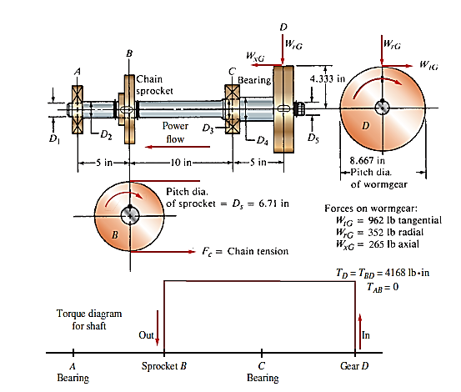

Slide 66
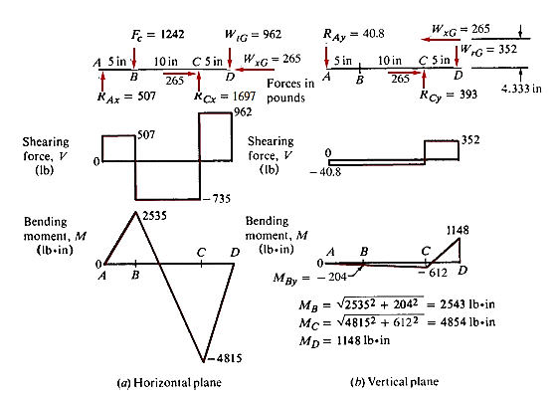

Slide 67
